Slide 1


IIAN Foundation &
Talent Network Update
May 21, 2024

Slide 2
We accomplished a lot in 3 years!
Success Factors Set in July 2021:
Continue College Partnerships – University of Nebraska system
Digital Marketing – Benchmark click-through-rate (CTR)
CareerPlug – adoption and conversion rates
New Hire Training

Slide 3
Major Focus – Set in 2021
Promote positive perception of insurance industry careers and independent agency system to students and college administrators.

Slide 4
College Partnerships - Careers
  Continued, built on UNK and UNO partnerships
  Expanded college outreach to include UNL
  Represented the Big “I” at career fairs, employer partner events, student activities

Slide 5
College Partnerships - Athletics
  Represented the Big “I” at Husker, Maverick athletic events
  Increased IIAN & Trusted Choice brand visibility to Husker, Maverick fans
  Received free Husker, Maverick tickets to give away to IIAN members & partners
  Digital advertising on UNL & UNO athletic websites and arena video boards
  Trusted Choice Marketing Reimbursement Grant

Slide 6
College Partnerships - Scholarships
  Established the Mark B. Lisko Big “I” Nebraska Scholarship at UNK in 2022
    $1,275 per year ($637.50 each awarded to 2 students)
    2024 recipients are Abigail Heins and Courtney Swisher

Slide 7
College Partnerships - Scholarships
  Next step is to establish a scholarship at UNO in memory of Greg Donsbach
    Minimum contribution of $2,125 required, plus a 5-year commitment
  What we need to give them:
    Fund Name
    Fund purpose & preferred selection criteria
    Initial annual donation amount

Slide 8
Secondary Focus – Set in 2021
Provide ways for job candidates and members to connect with each other – let them be responsible for the placement process

Slide 9

Learfield Digital Advertising
IIAN switched from I-CAN to Learfield for digital advertising
The results have been tremendously successful!!
  Millions of impressions, thousands of clicks
  Ads take them to the IIAN Job Board, iian.org/careers
Two different campaigns:
  Audience of college age students (18-24)
  Audience of job-changers, second career seekers

Slide 10
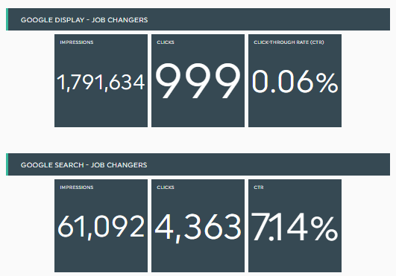
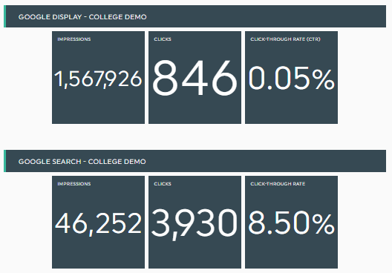
Learfield Stats as of 5/20/24
https://dashthis.com/app/view/dashboard-RzuUQGhbbUqqbfUZ4JSIXA?period=0

Slide 11
CareerPlug
IIAN Members who have activated their free accounts can post to their openings our job board
  58 member agencies have activated their free accounts
  Up from 34 in June 2022
5 member agencies utilize CareerPlug Pro or Premium, which include more hiring features and automatically shares their openings to all the top job boards
  Down from 10 in 2022, but paid plan pricing has increased
  Pro accounts receive more job applicants!

Slide 12
New Hire Training
IIAN established New Hire Training Program
  Pre-licensing classes through The Essential Step
  New Hire Training Courses on My Agency Campus
  Dive Deeper with CISR Designation & Elite Force Sales Academy

Slide 13

New Insurance Professional Scholarship
Established in 2022 for those new to insurance to earn a certificate or designation
  Year 1 Scholarship = up to $500
  Year 2-5 Scholarship = up to $1,000
  Offered in Jan/Feb and July/Aug
Recipients have attended Elite Force Sales Academy, IA-MBA, CISR, CIC courses
We typically only receive a few applicants, should we shift the timeline to promote at our conferences?

Slide 14
Back Burner - Internships
Most common question we get from students is, “Do you have any internships available?”
  I usually point them toward carriers for internships, but if there’s an agency with an internship available, please tell me!
Past Member Feedback
  Small group discussion/experience from prior efforts indicate that some agencies have implemented internships successfully, while most member agencies do not have the internal resources/time
Existing Resources
  Promote InVEST internship guide & materials
  Promote internship guide developed by former Talent Network program director

Slide 15
What’s Next?
What should success look like at the end of 2027?
Set new goals –
  What do you want to continue?
  Where should we shift our direction?
Break goals out by year (3-year timeline)

